Slide 1

Idiographic Personality: A Methodological Perspective on Measuring and Modeling Individuals
Emorie D. Beck and Joshua J. Jackson
Washington University in St. Louis

Slide 2
Extraversion
Agreeableness
Conscientiousness
Neuroticism
Openness
Nomothetic

Slide 3
Extraversion
Agreeableness
Conscientiousness
Neuroticism
Openness
Idiographic

Slide 4
Personality
Cognitive Affective
Rude
Quiet
Lazy
Relaxed
Depressed
Outgoing
Kind
Reliable
Worried
Academic Motivation
Around Others
Connected
Positive Emotion
Negative Emotion
Authenticity
Self-Esteem
Happiness
Loneliness

Slide 5
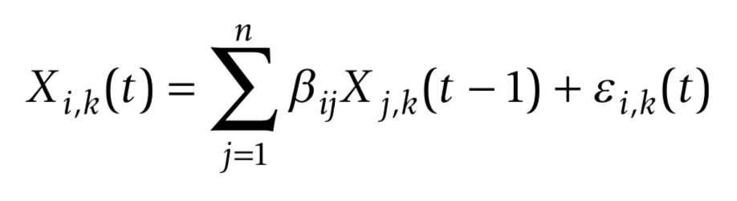
Idiographic Assessment: Graphical Autoregressive Models
k = subjects
i = item
j = item
t = assessment point
Personality
Cognitive Affective
Rude
Quiet
Lazy
Relaxed
Depressed
Outgoing
Kind
Reliable
Worried
Academic Motivation
Around Others
Connected
Positive Emotion
Negative Emotion
Authenticity
Self-Esteem
Happiness
Loneliness
Wild et al., 2010; Epskamp, Waldorp, Mõttus, & Borsboom (2018)

Slide 6
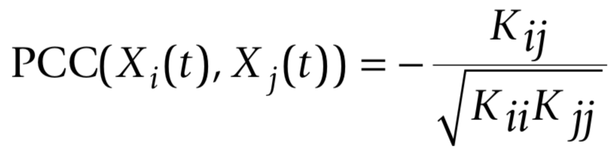
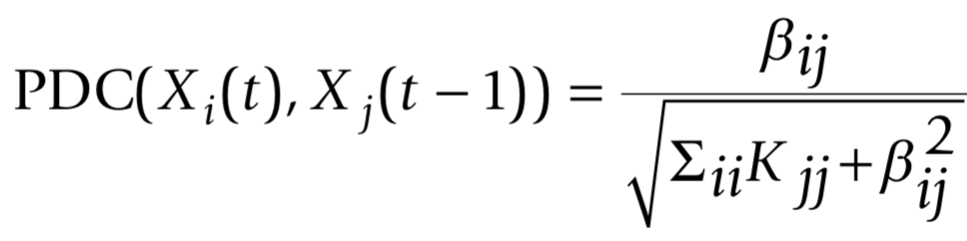
Idiographic Assessment: Graphical Autoregressive Models
k = subjects
i = item
j = item
t = assessment point
K = concentration matrix
(inverse variance-covariance matrix)
Wild et al., 2010; Epskamp, Waldorp, Mõttus, & Borsboom (2018)

Slide 7
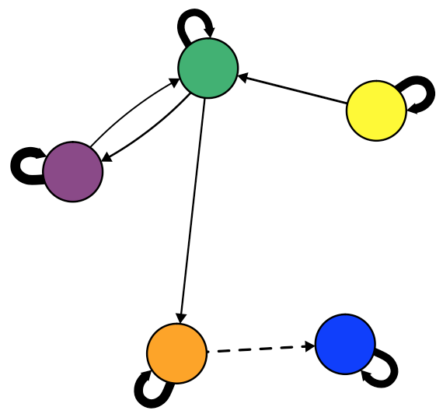
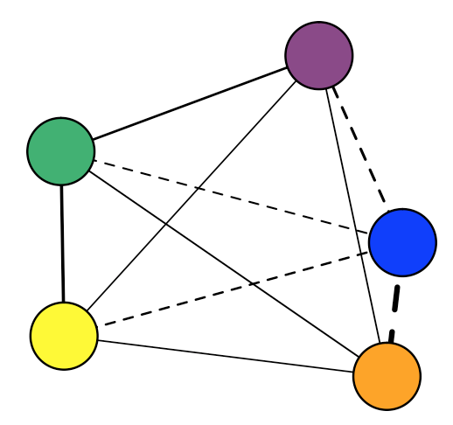
Epskamp, Waldorp, Mõttus, & Borsboom, 2017

Slide 8
Contemporaneous
Concurrent behaviors: While…
Within Time-Points:
X_{it}←→X_{jt}
Epskamp, Waldorp, Mõttus, & Borsboom, 2017

Slide 9
Contemporaneous
Concurrent behaviors: While…
Temporal
Contingent behaviors: If…Then…
Within Time-Points:
X_{it}←→X_{jt}
Between Time-Points:
X_{it}→X_{i, t+1}
Epskamp, Waldorp, Mõttus, & Borsboom, 2017

Slide 10
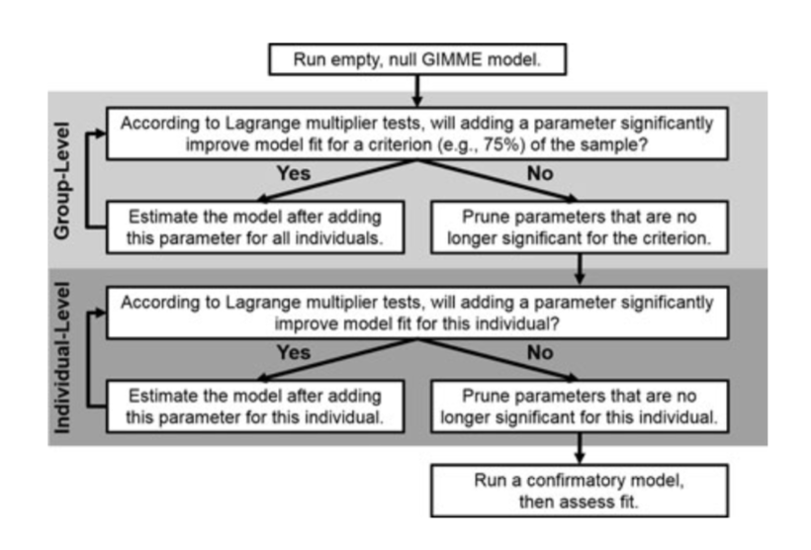
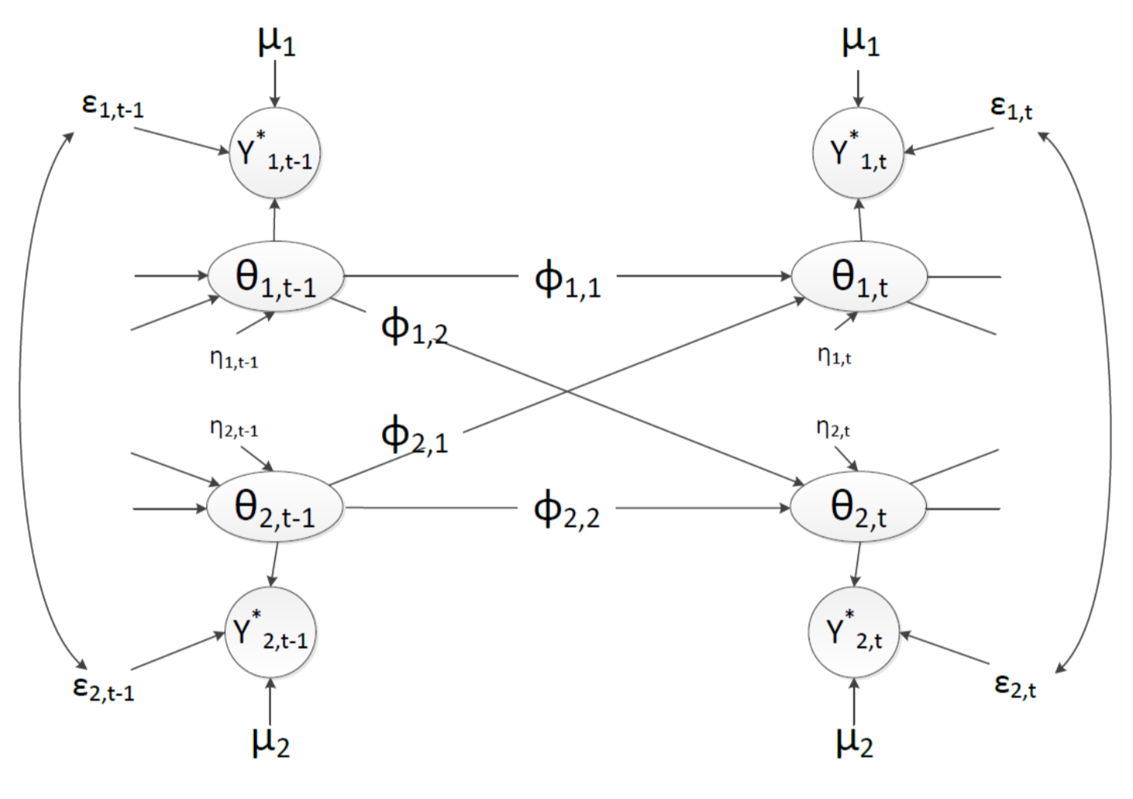
GIMME
VAR Bayesian Dynamic Model
Beltz & Gates, 2017; Wright et al., 2017
Krone, Albers, Kuppens, & Timmerman, 2017

Slide 11
Promises | Challenges
What does idiographic assessment and modeling buy us, and how do we do it well?

Slide 12
Promises | Challenges
Structure

Slide 13
Promises | Challenges
Structure
Process
Triggering Situations
Expectancies
States /
State
Expression
Re-
Actions

Slide 14
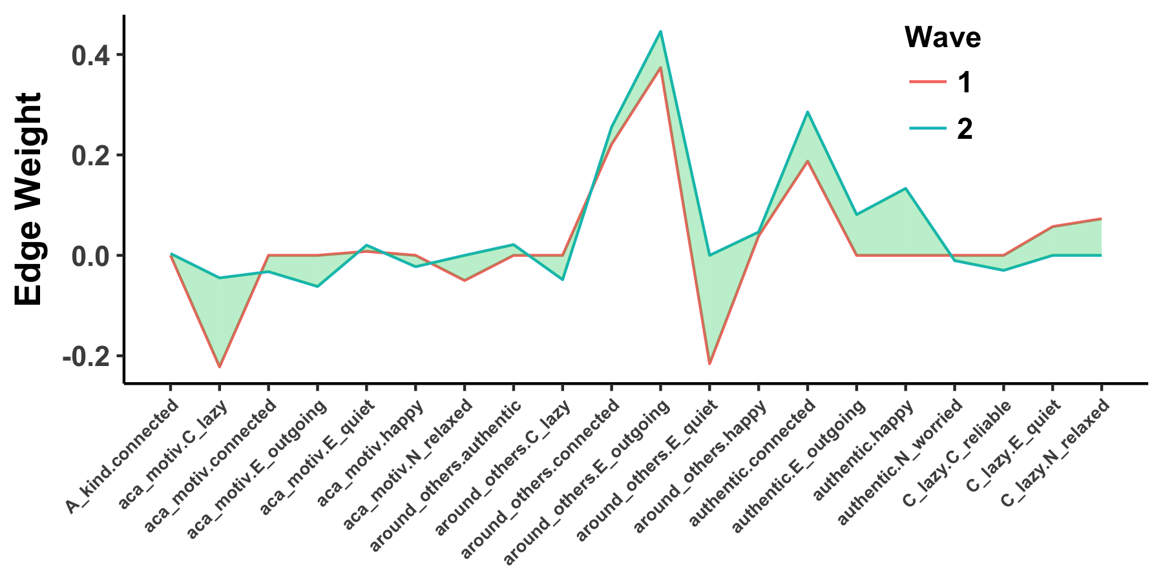
Promises | Challenges
Structure
Process
Triggering Situations
Expectancies
States /
State
Expression
Re-
Actions
Development

Slide 15
Promises | Challenges
Structure
Process
Triggering Situations
Expectancies
States /
State
Expression
Re-
Actions
Development
psyarxiv.com/pb92q

Slide 16
Promises | Challenges
Structure

Slide 17
Promises | Challenges
Structure
Academic motivation – lazy

Slide 18
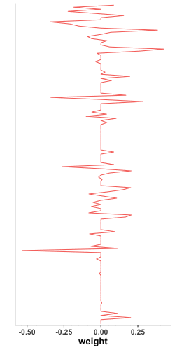
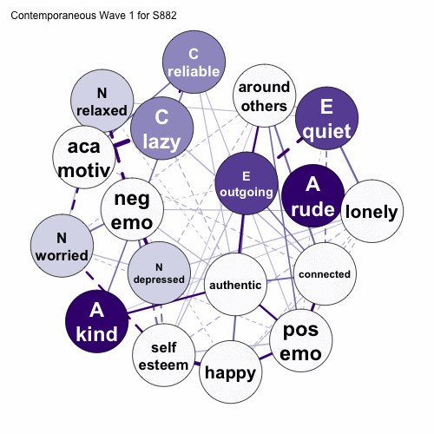
Promises | Challenges
Structure

Slide 19
Promises | Challenges
Structure

Slide 20
Promises | Challenges
Structure
Temporal
Contingent behaviors: If…Then…
X₁₁
X₁₂
X₁₃
. . .
X_{1j}
X₂₁
X₂₂
X_{2j}
X₃₁
X_{3j}
. . .
. . .
. . .
X_{i1}
. . .
X_{ij}
Between Time-Points:
X_{it}→X_{i, t+1}

Slide 21
Promises | Challenges
Structure
Contemporaneous
Concurrent behaviors: While…
1
X₁₂
X₁₃
. . .
X_{1j}
X₂₁
1
X_{2j}
X₃₁
X_{3j}
. . .
. . .
. . .
X_{i1}
. . .
1
Within Time-Points:
X_{it}←→X_{jt}

Slide 22
Promises | Challenges
Personality Processes
T riggering Situations
E xpectancies
S tates /
S tate
E xpression
R e-
A ctions
Wrzus & Roberts, 2017

Slide 23
Promises | Challenges
Personality Processes
T riggering Situations
E xpectancies
S tates /
S tate
E xpression
R e-
A ctions
Wrzus & Roberts, 2017

Slide 24
Promises | Challenges
Personality Processes
T riggering Situations
E xpectancies
S tates /
S tate
E xpression
R e-
A ctions

Slide 25
Promises | Challenges
Personality Processes
Personality
Notes:
One way to think about this is to build networks with “traditional” manifestations of personality and then iteratively add single processes and examine how its addition influences the relationships among personality manifestations. So here you see a temporal personality network with 9 nodes of personality manifestations and the relationships among them.
Now, observe what happens when I add in a triggering situation

Slide 26
Promises | Challenges
Personality Processes
Personality
Personality + Triggering Situations
Notes:
And then we can add an expectancy and observe the change

Slide 27
Promises | Challenges
Personality Processes
Personality
Personality + Triggering Situations
Personality + Expectancies
Notes:
And finally we’ll add a personality state and observe the change

Slide 28
Promises | Challenges
Personality Processes
Personality
Personality + Triggering Situations
Personality + Expectancies
Personality + State Expression
Notes:
It’s a little difficult to observe the changes that happen here, so we look at the profiles of edge weights like we did before and see how adding these processes influences the relationships among the prsoanlity manifestations

Slide 29
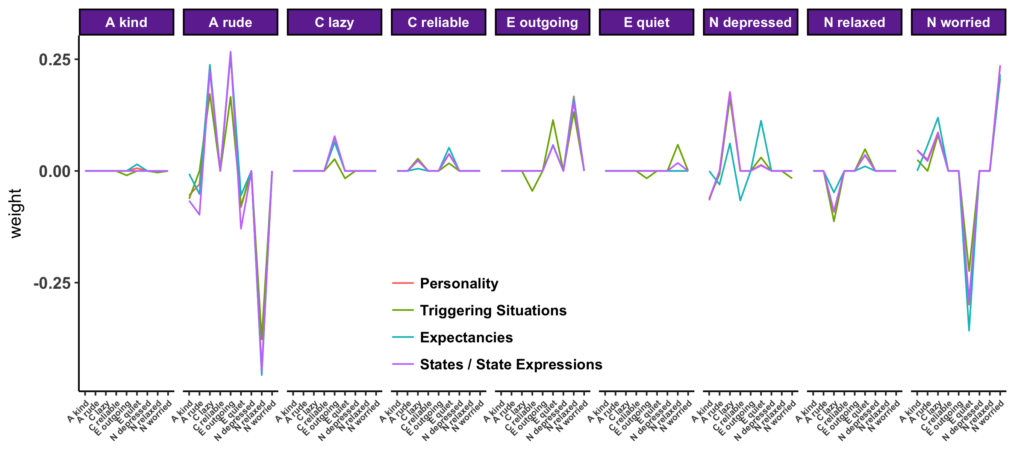
Promises | Challenges
Personality Processes

Slide 30
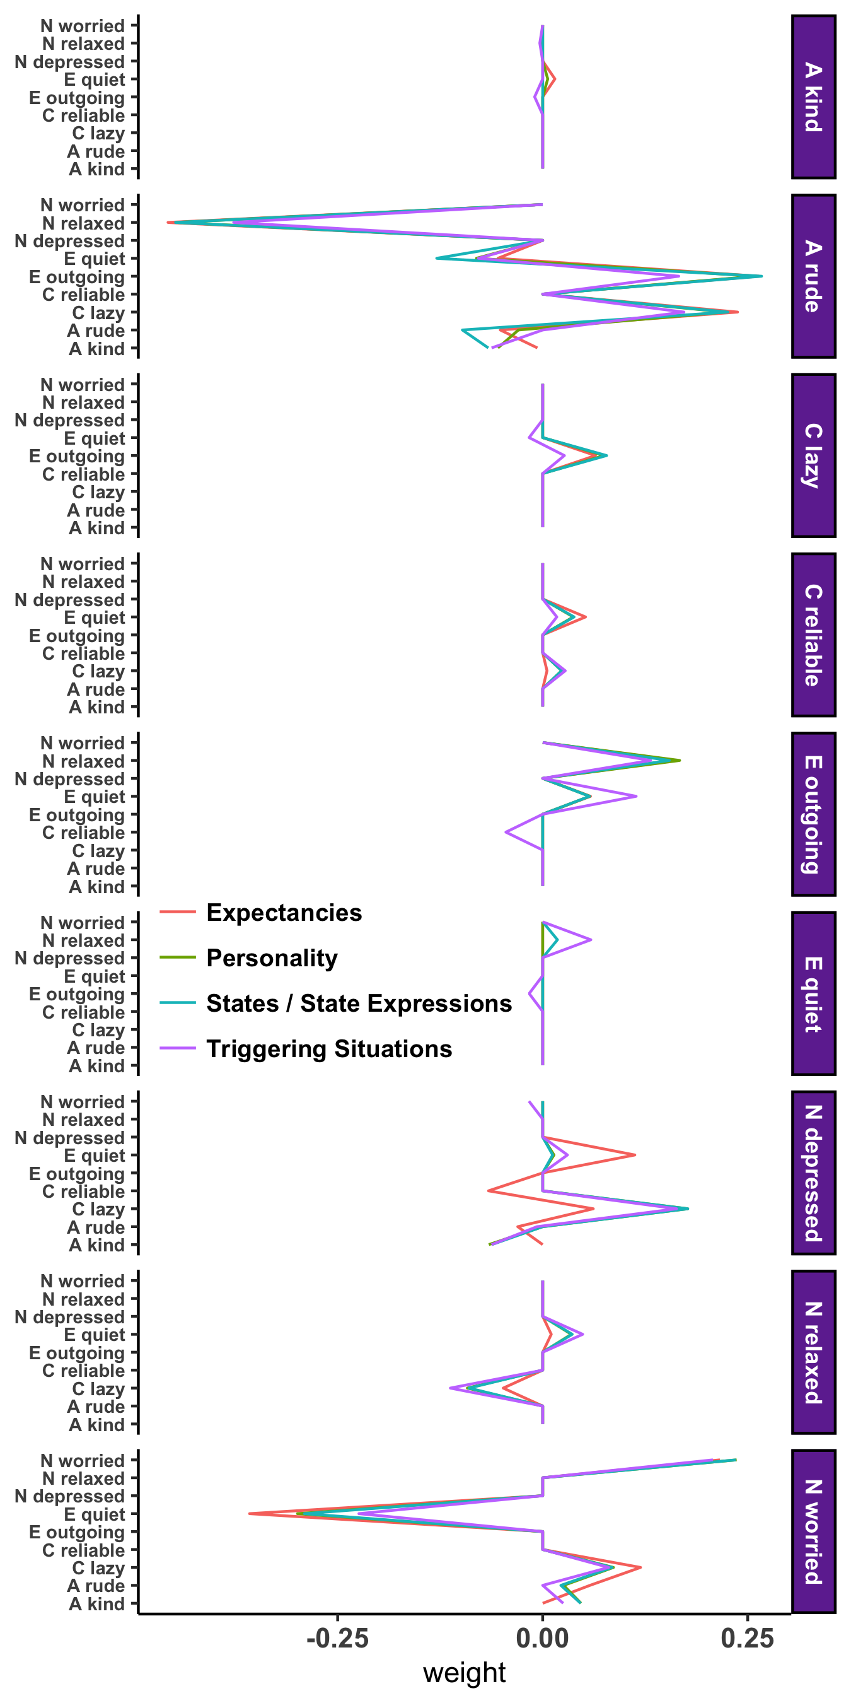
Promises | Challenges
Personality Processes
Notes:
Zooming in, we see that adding the expectancy (academic motivation) to the network, influences the relationship between current personality manifestations and future depression, with, for example a weaker positive relationship between current laziness and future depression, suggesting that academic motivation influences this if…then contingency

Slide 31
Promises | Challenges
Development
Beck & Jackson (under review)
Notes:
Finally, idiographic personality networks can inform our understanding of personality development. Instead of conceptualizing personality development as mean level or rank order change across people over time, we can examine change within a person relative to him or herself.

Slide 32
Promises | Challenges
Development
Beck & Jackson (under review)
Notes:
Consider the two networks you see here. They represent data collected from the same individual one year apart. As you can see from the profile on the right, there was some consistency in the participants’ profile over two years as evidenced by the correlation you see at the top of the profile, but there was also a large degree of change, as evidenced by the differences between the red and blue lines on the profile.

Slide 33
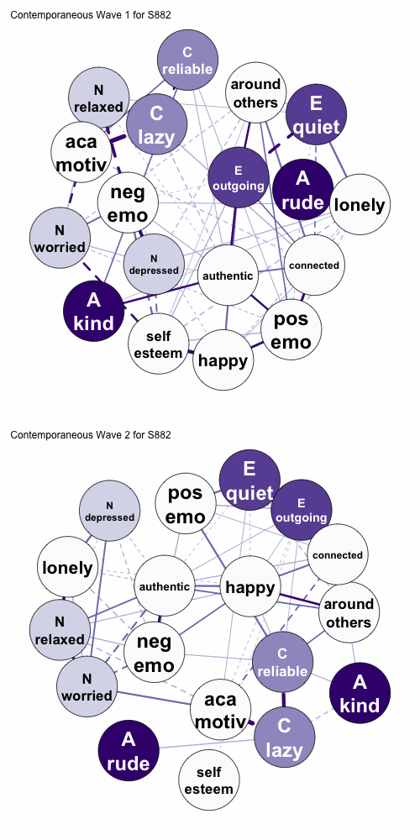
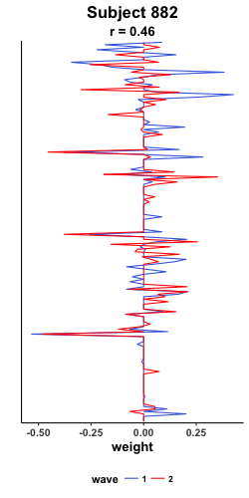
Promises | Challenges
Development
Beck & Jackson (under review)
Notes:
We can then look at this for every participant in our sample and collect the correlation of their ipsative consistency into a distribution.

Slide 34
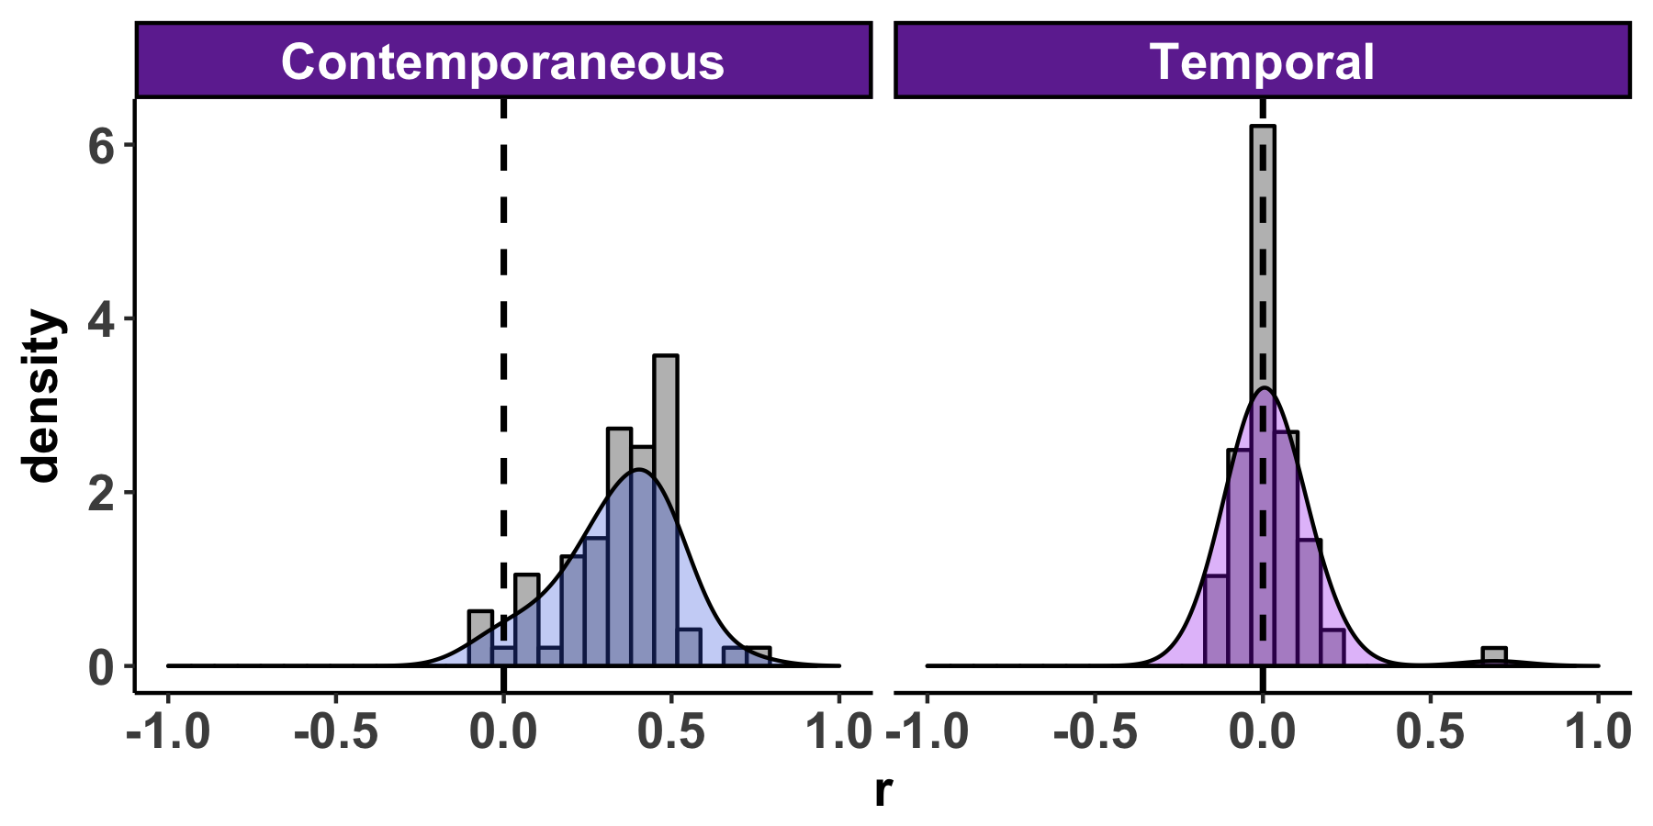
Promises | Challenges
Development
Beck & Jackson (under review)

Slide 35
Promises | Challenges

Slide 36
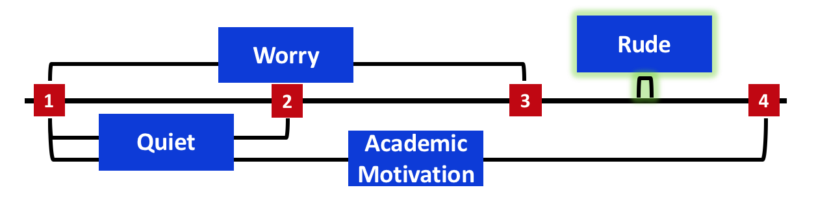
Promises | Challenges
Velocity

Slide 37
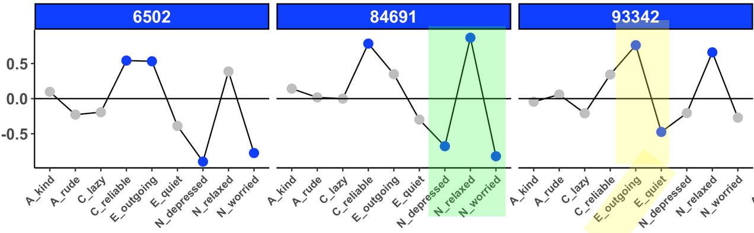
Promises | Challenges
Velocity
Psychometrics

Slide 38
Promises | Challenges
The Time Interval Problem
Psychometrics
Aggregation
Centrality
Clustering
Density
Communities

Slide 39
Promises | Challenges
The Time Interval Problem
4 hours
1
2
3
4
Worry
Academic Motivation
Quiet
Rude

Slide 40
Promises | Challenges
The Time Interval Problem
Worry
1
2
3
4
Academic Motivation
Quiet
Rude

Slide 41
Promises | Challenges
The Time Interval Problem
Worry
1
2
3
4
Quiet
Academic Motivation
Rude

Slide 42
Promises | Challenges
The Time Interval Problem
Worry
1
2
3
4
Quiet
Academic Motivation
continues
Rude

Slide 43
Promises | Challenges
The Time Interval Problem
Worry
Rude
1
2
3
4
Quiet
Academic Motivation
continues

Slide 44
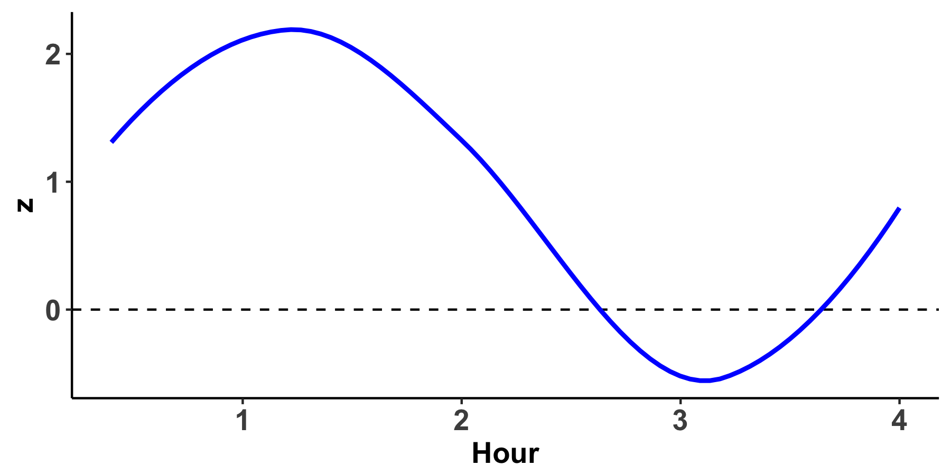
Promises | Challenges
Velocity
Worry
Rude
1
2
3
4
Quiet
Academic Motivation
continues

Slide 45
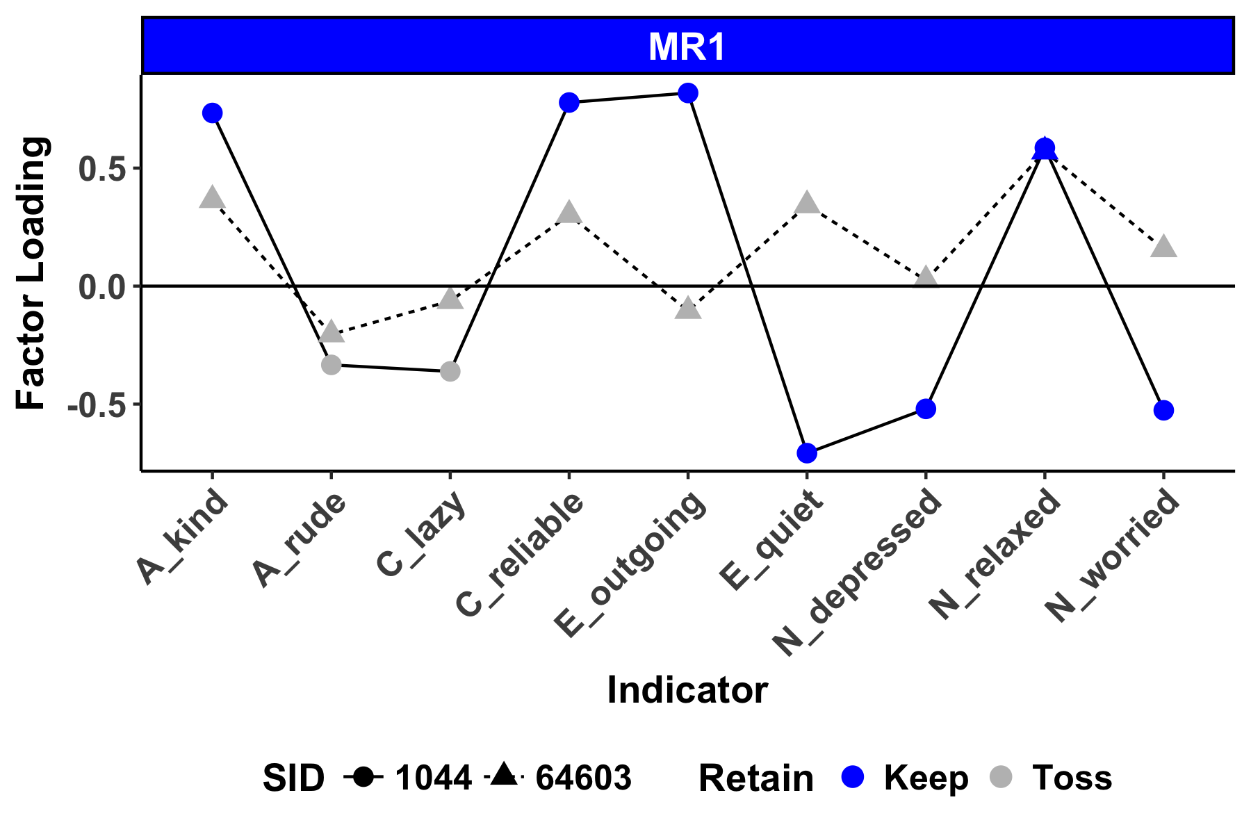
Promises | Challenges
Psychometrics
Borkenau & Ostendorf, 1998;Molenaar, 2004

Slide 46
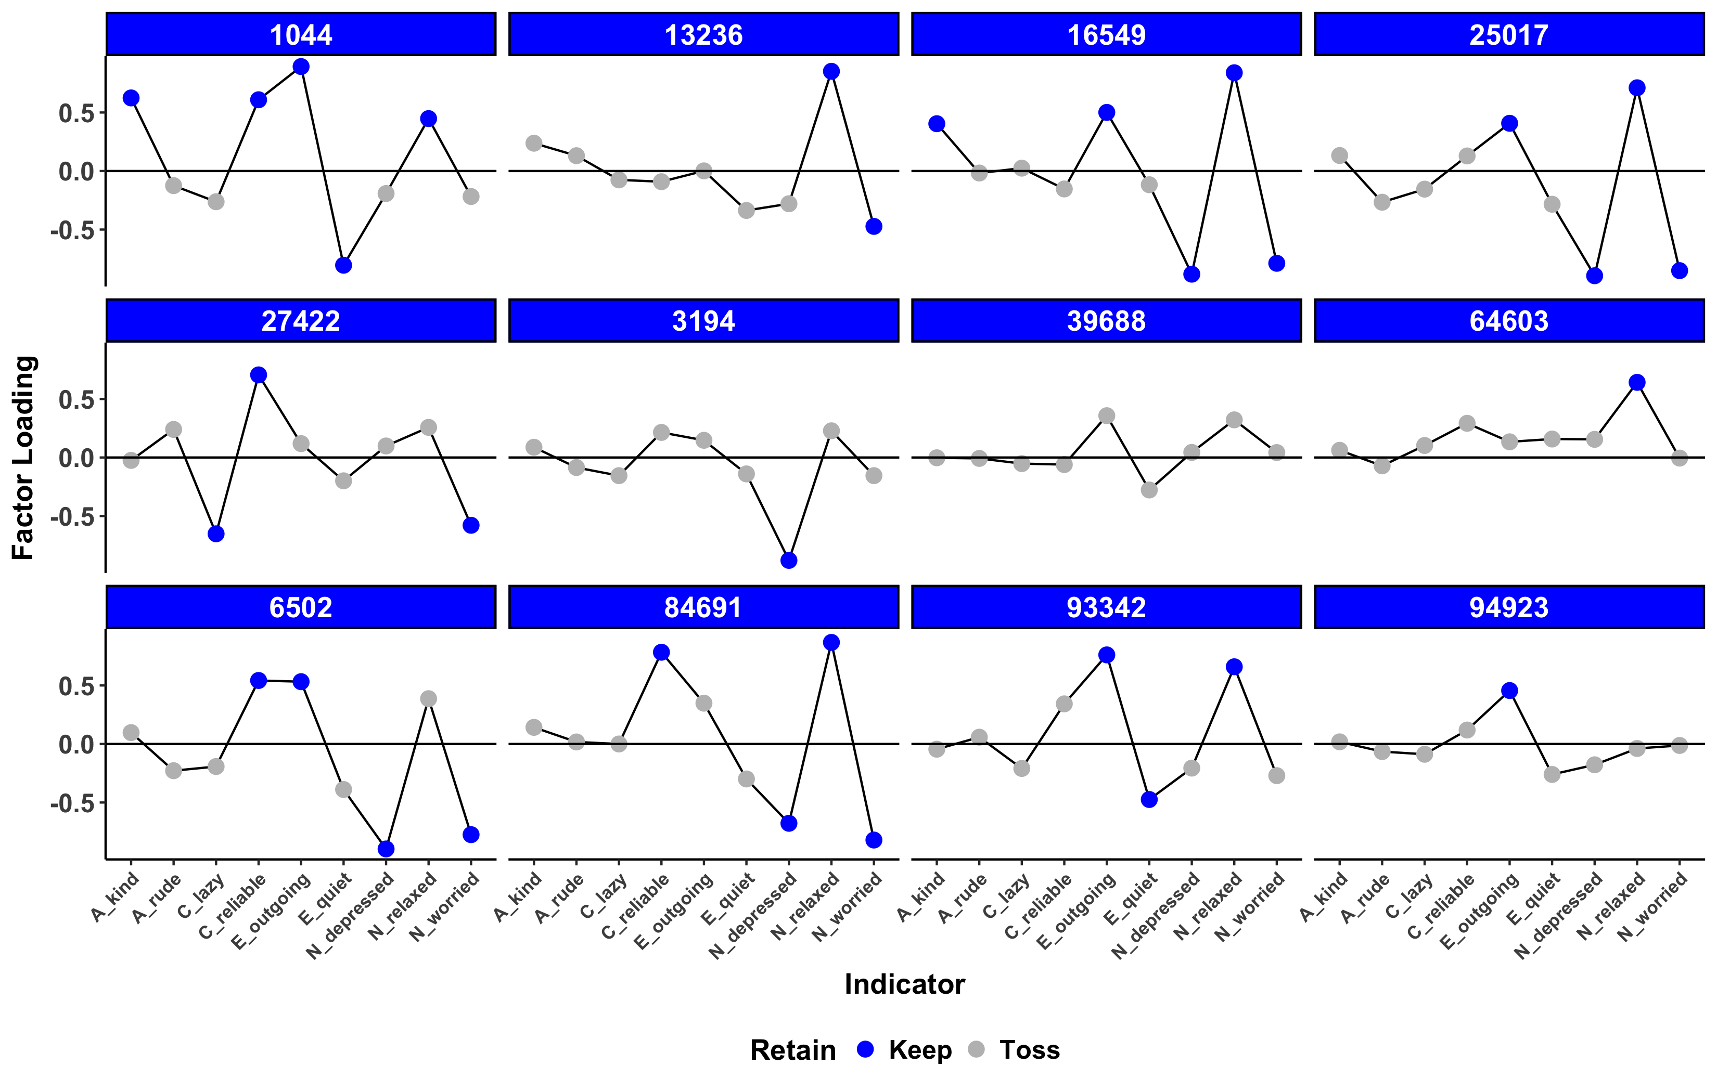
Promises | Challenges
Psychometrics

Slide 47
Promises | Challenges
Aggregation

Slide 48
Promises | Challenges
Aggregation
Centrality

Slide 49
Promises | Challenges
Aggregation
Centrality
Density

Slide 50
Promises | Challenges
Aggregation
Centrality
Density
Clustering
Communities
Innovation
Variability

Slide 51
Promises | Challenges
Summary
Structure
The Time Interval Problem
Process
Psychometrics
Development
Aggregation

Slide 52
Promises | Challenges
Summary
The Time Interval Problem
Process
Psychometrics
Development
Aggregation

Slide 53
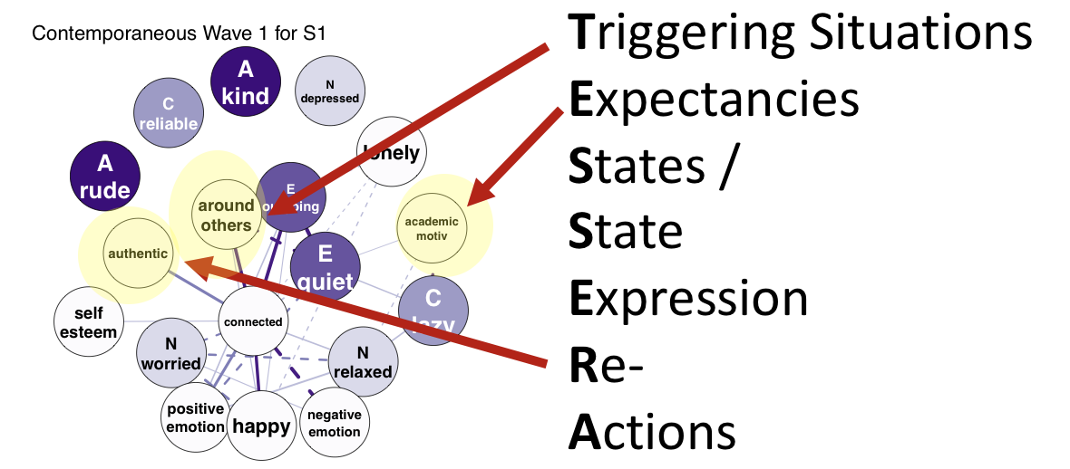
Promises | Challenges
Summary
The Time Interval Problem
Psychometrics
Development
Aggregation

Slide 54
Promises | Challenges
Summary
The Time Interval Problem
Psychometrics
Aggregation

Slide 55
Promises | Challenges
Summary
Psychometrics
Aggregation

Slide 56
Promises | Challenges
Summary
Aggregation

Slide 57
Promises | Challenges
Summary
Centrality
Clustering
Density
Communities

Slide 58
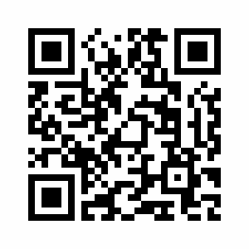
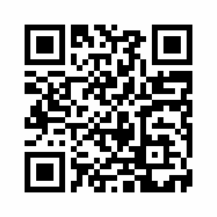
Questions?
Special Thanks to:
Josh Jackson
The PMaD Lab
(And the people who brought us PAIRS data)
Results:
https://pmdlab.wustl.edu/Beck_APS_2018.html
Data and Code:
https://github.com/emoriebeck/APS_2018

Slide 59

Promises | Challenges
Scale Development in ESM

Slide 60
Promises | Challenges
Where do we go from here?
Measurement
Methodology
Modeling

Slide 61
Promises | Challenges
Where do we go from here?
Measurement
Methodology
Modeling
Adaptive Measurement
Pre-Defined Idiographic Assessments
Timing of Personality Manifestations

Slide 62
Promises | Challenges
Where do we go from here?
Measurement
Methodology
Modeling
Adaptive Measurement
Planned Missing Data Designs
Pre-Defined Idiographic Assessments
Longitudinal Assessments
Timing of Personality Manifestations
Intervention Studies

Slide 63
Promises | Challenges
Where do we go from here?
Measurement
Methodology
Modeling
Adaptive Measurement
Planned Missing Data Designs
Sparse Modeling Techniques
Pre-Defined Idiographic Assessments
Longitudinal Assessments
Incorporating additional dynamic measures
Timing of Personality Manifestations
Intervention Studies
Multivariate Dynamic Models

